Slide 1
Update on operant conditioning analysis: What is done with the push of a button
5.14.18
Guillaume

Slide 2
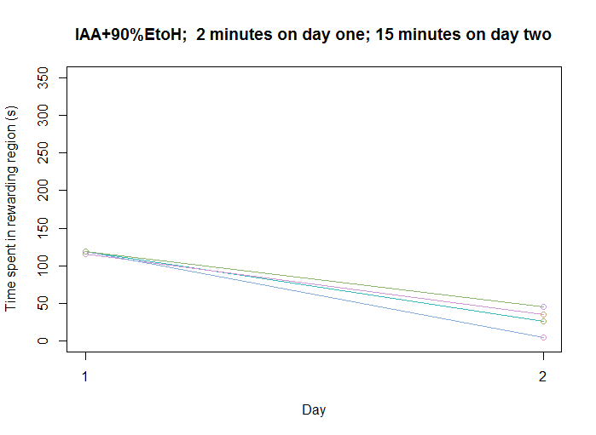
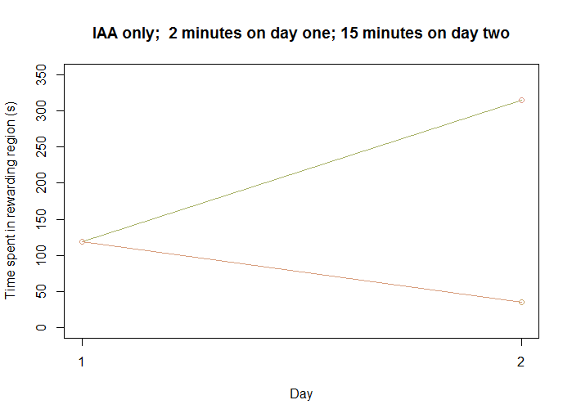
1) Number of seconds in rewarding region
Option to give each fly its own plot w/ id so you can identify outliers

Slide 3
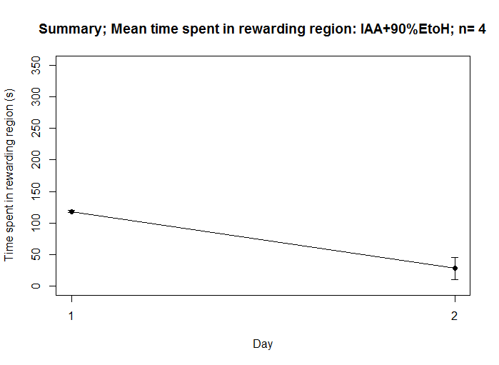
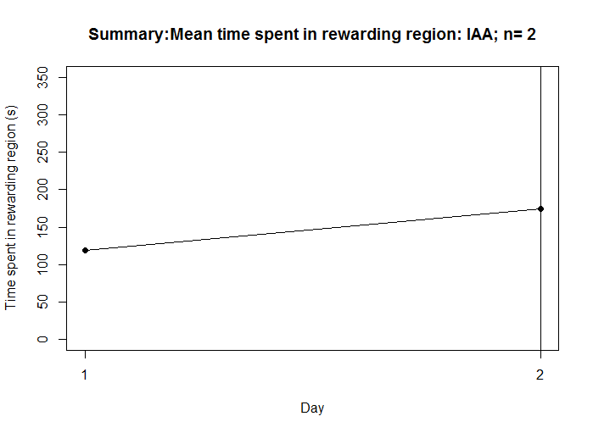
1) Number of seconds in rewarding region: summary
Summary graphs

Slide 4
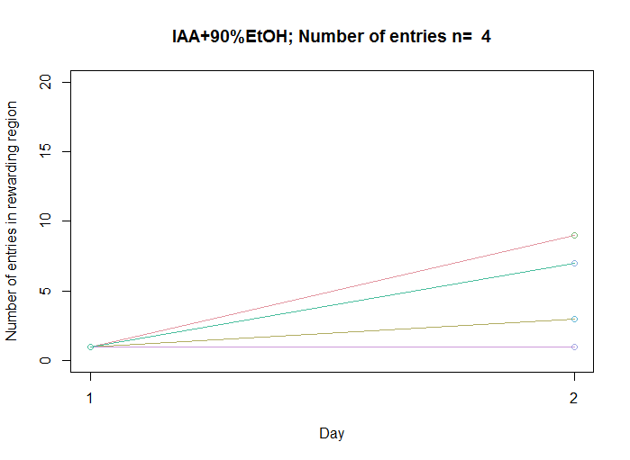
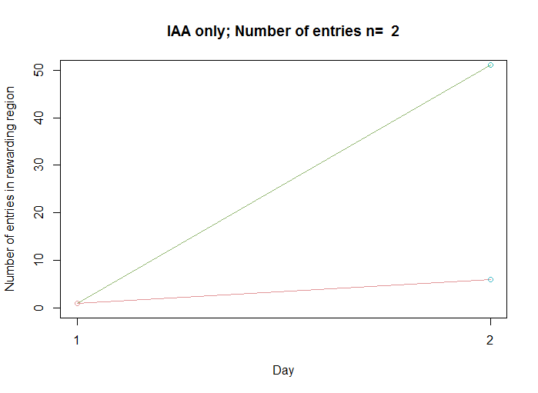
2) Number of entries
Note: Day 1 isn’t informative in this case because it’s forced training i.e. 120 seconds-1 entry

Slide 5
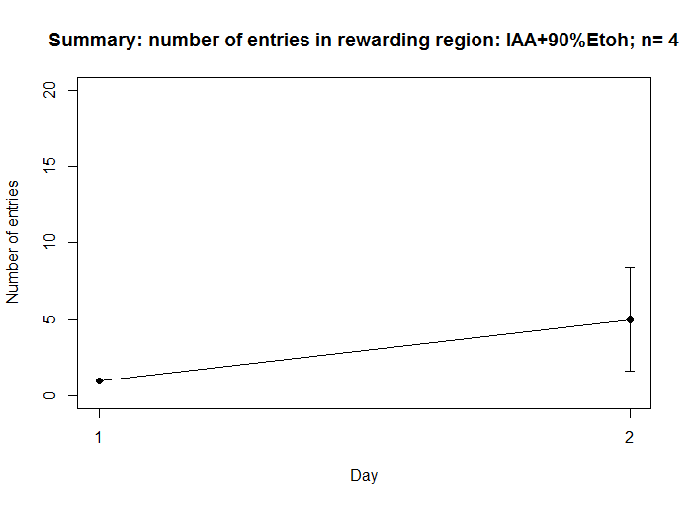
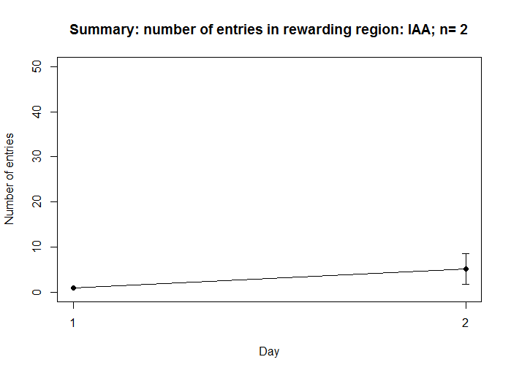
2) Number of entries: summary

Slide 6
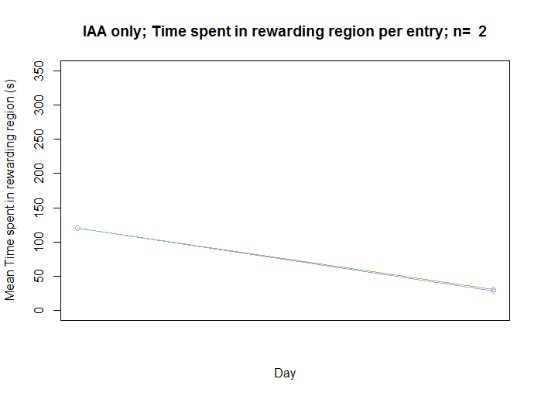
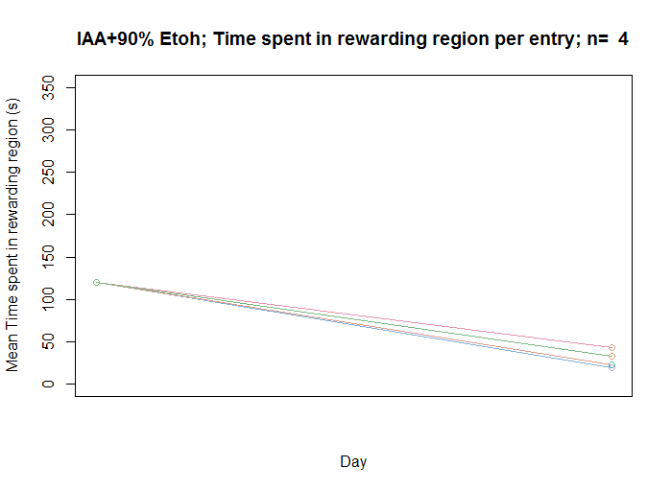
3) Average time per entry

Slide 7
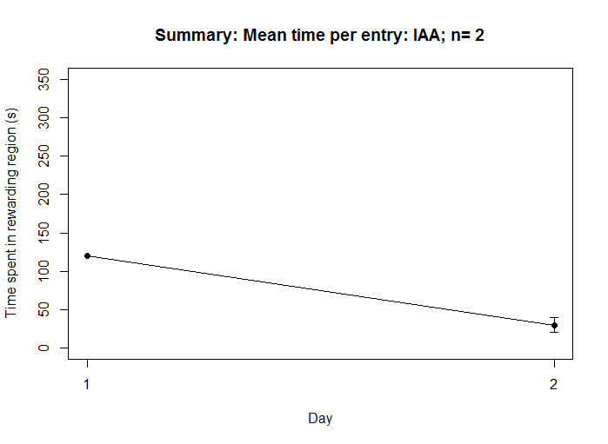
3) Average time per entry: summary

Slide 8
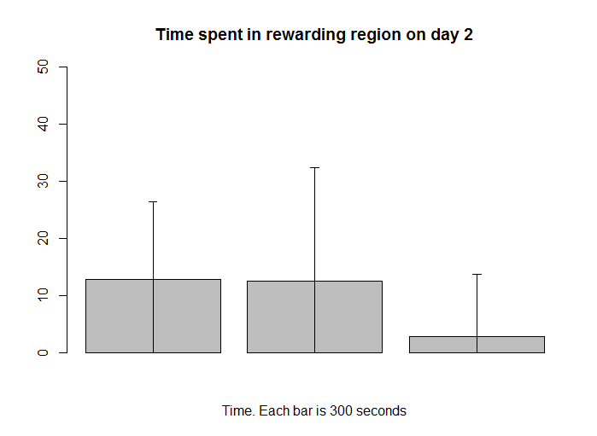
Breaking down by time – possible for all three metrics

Slide 9
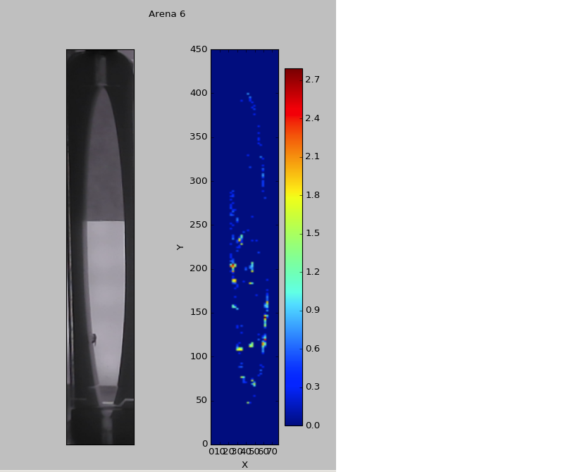
Additional forms of analysis
Heatmap
Fly trajectory

